Slide 1
Interim Overview and goals of analysis- Option I:
Compile database of all invaded islands (>= 1ha in size) throughout the NZ archipelago that contain invasive mammals. Then, determine island eradication status/censorship, where: 1 = eradicated (invasive mammal pest-free), and 0 = currently inhabited by invasive mammals.
Gather covariates hypothesized to affect eradication time (e.g. island area, eradication method, island ownership, etc.)
Gather distribution types hypothesized to explain the probability of successfully eradicating island invasive pests (e.g. distribution that takes on two phases, where the 1st phase has the form of a slow decline followed by a 2nd phase exhibiting a very steep decline).
Plot the Kaplan-Meier non-parametric survival function with the island eradication status data.
Graph the parametric survival functions of the chosen distributions and compare them with the non-parametric Kaplan-Meier curve, via maximum (log)likelihood estimation, to determine the best distribution type.
Alternatively we can assess the distribution fit using the complimentary log-log transformation of survival probability versus log survival time- if the survival data fit a linear version of the distribution (y=b+mlog(t), where b= (-log(alpha)/(1/sigma)), m=1/sigma), then the distribution is a good fit.
With the chosen distribution, use parametric regression techniques to determine the group of explanatory variables (step #2) that best explain eradication time, via AIC.
Compare the effects of differing technologies on eradication time and survival probability by looking at how they influence the model behaviour.
Possibly use the PDF instead of hazard here because it looks at failure probability over the entire analysis lifespan as opposed to instantaneous failure probability
Use of the accelerated failure time (ATF) for parametric models can allow for easy interpretation- the direct relationship between predictors and survival time is useful. The largest positive hazard ratio of the parametric regression will also provide clues as to what the best tech may be.

Slide 2
Interim Overview and goals of analysis- Option II:
Compile database of all invaded islands (>= 1ha in size) throughout the NZ archipelago that contain invasive mammals. Then, determine island eradication status/censorship, where: 1 = eradicated (invasive mammal pest-free), and 0 = currently inhabited by invasive mammals.
Gather covariates hypothesized to affect eradication time (e.g. island area, eradication method, island ownership, etc.)
Plot the Kaplan-Meier non-parametric survival function with the island eradication status data.
Use semi-parametric regression techniques – the Cox Proportional Hazards Model- to fit the given explanatory variables with the survival curve; select the model that best explains eradication time, via maximum likelihood→ AIC.
From the best model options, fit the Kaplan-Meier curve to the proportional hazards survival distribution via maximum log-likelihood. Select the one model that best fits the KM curve.
Compare the effects of differing technologies on eradication time by looking at how they influence the model behaviour.
Possibly use the PDF instead of hazard here because it looks at failure probability over the entire analysis lifespan as opposed to instantaneous failure probability
The largest positive hazard ratio of the parametric regression will also provide clues as to what the best tech may be.
The cox model will allow for estimation of the baseline hazard at some time point- comparisons can be made

Slide 3
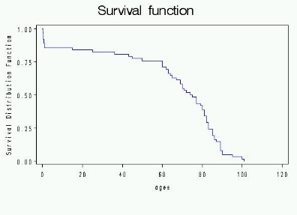
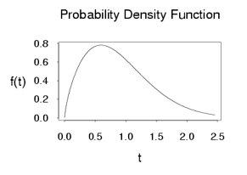

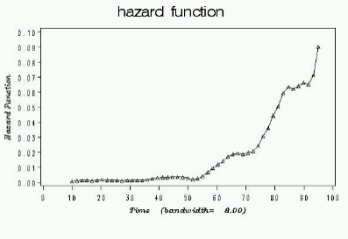
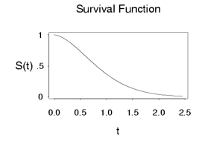
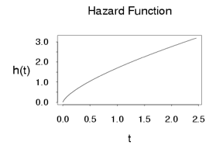
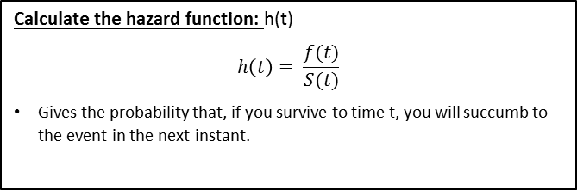

Event data 0 = non-event | 1= event Analysis takes place over some chosen timeframe
Survival Analysis: Statistical method for analysing longitudinal data (where the same sample is tracked at different points in time) on the occurrence of events. In this case, we are interested in the time to island eradication concerning invasive mammalian pests.
Survival Analysis Track A: Non-parametric survival curve comparisons
Step 1:
Step A1:
From the event data:
Attain the probability density function (pdf): ƒ(t)
The probability of the failure time occurring (1’s) at exactly time t (out of the whole range of possible t’s).
Can determine the probability of failure throughout the entire range of possible failures given in the dataset.
Ex: highest prob. of failure (~80%) at time (t) = 0.5
Kaplan-Meier Survival Curve Estimation:
Non-parametric estimate of the survival function- no assumptions used to generate the model.
Is simply the empirical probability of surviving past certain times in the sample while taking in to account censoring.
Can be used to generate a non-parametric version of the hazard function.
Step 2:
Step A2:
Calculate the cumulative Survival Function: S(t)
$$S\left(t\right)=1−P\left(T≤t\right)=1−F(t)$$
Where: F(t) is the cumulative distribution function (CDF, a compliment to the survival function).
Allows us to estimate and compare survival experiences of different groups, or understand survival of a single group.
The survival function plots the same data as the PDF, but is plotted as a cumulative distribution rather than a density.
Ex: survival prob. at time (t) = 0.5 is ~75%
Product-limit Estimation:
Step A3:
Log-Rank Test survival function comparison:
Step 3:
Calculate the hazard function: h(t)
$$h\left(t\right)= \frac{f(t)}{S(t)}$$
Gives the probability that, if you survive to time t, you will succumb to the event in the next instant.

Slide 4
From previous (with the given event data):
Chosen covariates Predicted to influence the event (eradication) over time (time to erad.)
Survival Analysis Track C: Semi-parametric regression techniques with the Cox proportional hazards model
Survival Analysis Track C (CONTINUED): Semi-parametric regression techniques with the Cox proportional hazards model
Models the effect of predictors and covariates on the hazard rate but leaves the baseline hazard rate unspecified.
Does not assume knowledge of absolute risk.
Allows for a baseline hazard function that is left unspecified but must be positive- is therefore more robust than parametric methods.
The point is to compare the hazard rates, given in hazard ratios (HR), of individuals who have different covariates:
Because of this, the hazard functions need to be parallel.
Interpretation through HR: HR>1 means the event is more likely to occur, HR<1 means event is less likely to occur. HR=1.0 means predictor has no effect on the hazard.
Cox Regression Analysis Assumptions (Continued):
For categorical covariates that refute the PH assumption:
-Include the interaction of the covariate with time in the model : time * covariate – PH assumption supported by non-significant interaction coefficient and refuted by a significant interaction coefficient. Retaining the interaction term in the model corrects for violation of PH.
-Stratification – Different stratum are allowed to have different baseline hazard functions. Hazard functions do not need to be parallel between different stratum.
Model Selection: We may fit a model with all covariates as predictors, and then use backwards stepwise regression, using the AIC as a measure of goodness of fit, to select the best model.
Model Fit for Coefficients: Residuals- used to investigate the lack of fit of a model to a given subject.
There is no easy analogue to the residuals used in linear regression (e.g. observed minus predicted) for survival analysis.
Martingale Residuals – gives excess failures but is difficult to interpret because they are not symmetrically distributed (even when the model is fitted correctly), although have the benefit of showing us the functional form of the covariate if it is non-linear (produced curve will deviate from zero and often not be very linear.
We often transform martingale residuals to deviance residuals to easily asses the fit of covariate to the model:
Deviance residuals are a normalized transform of the martingale residual, symmetrically distributed around zero.
Observations with large deviance residuals are poorly predicted by the model- should be symmetrically distributed around 0 and have a standard dev of 1.0. Negative for observations with longer than expected observed survival times.
Plot deviance residuals against covariates to look for unusual patterns.
Difference between cox regression and logistic regression:
If the outcome observed is “either-or”, such as if death occurred or did not occur, logistic regression can be used. However, if the time to death is the observed outcome, survival analysis should be used.
Cox Regression Analysis Assumptions- Assumes proportional hazards (and multiplicative risk):
Testing PH assumption for continuous covariates:
-plot the Schoenfeld Residuals –PH assumption supported by a random pattern centred around 0, and refuted by a non-random pattern.
-Regress the Schoenfeld residuals against time to test for independence between residuals and time- PH assumption supported by a non-significant (p>0.05) residual and time, and is refuted by a significant relationship.
Testing PH assumption for categorical covariates:
-examine the log(-log S(t)) plot → assessment of the parallel cumulative hazard plot – PH assumption supported by parallel lines and refuted by lines that cross.

Slide 5
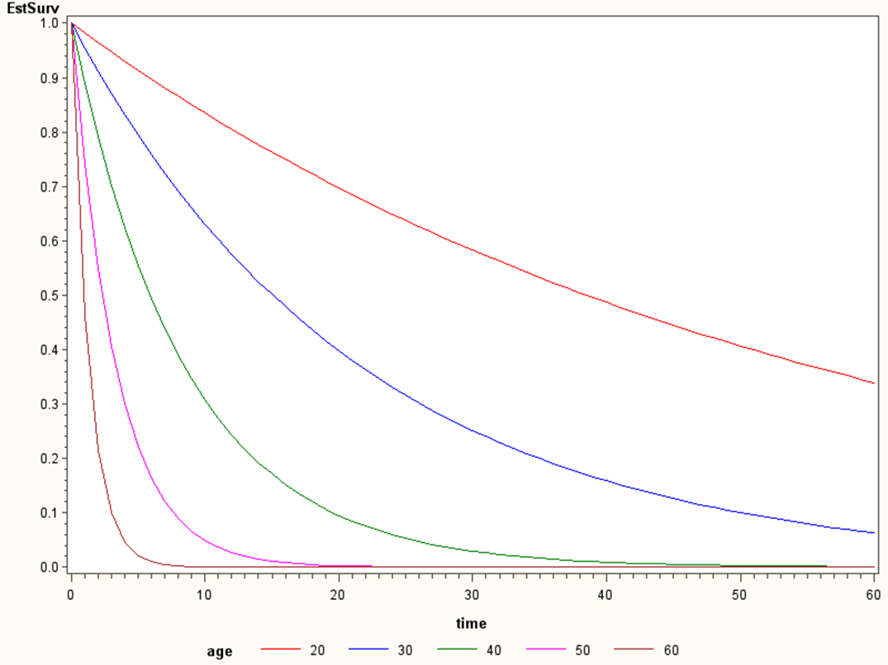
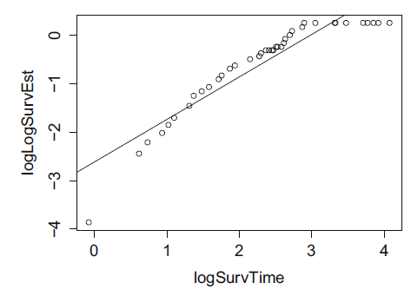






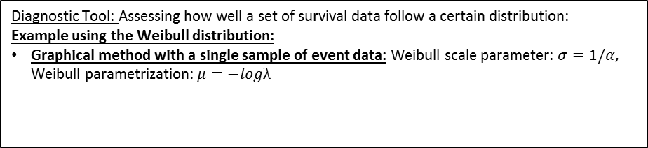

Survival Analysis Track B: Parametric Multivariate Regression Techniques
Survival Analysis Track B (Continued): Parametric Regression Techniques
Weibull distribution (with mu shape and alpha scale)
Diagnostic Tool Continued:
The supplied equation suggests a diagnostic tool to assess how well a set of survival data will fit a Weibull distribution.
Compute the Kaplan-Meier curve of the given survival data (S hat).
Fit the KM curve (S hat) to the below log-log function and plot y_i vs log(t_i):
Fit the generated points through a straight line distribution (y=b+mlog(t), where b= (-log($α$)/(1/ $σ$)), m=1/ $σ$). If the plotted points fall along the line, we can conclude that the survival data can be approximately modelled using a Weibull distribution.
Goal of parametric regression in survival analysis:
Model the underlying hazard function under the assumption that the dependent variable (time-to-event) takes on some known distribution (e.g. Weibull, exponential, etc.).
These techniques will estimate parameters of the chosen distribution (e.g. the baseline hazard).
Estimates covariate adjusted hazard ratios.
The Weibull distribution may not be a good fit for this data.
Parametric regression components:
A baseline hazard function (which may change over time)
A linear function of a set of k fixed covariates that, when exponentiated, gives the relative risk.
EX: The exponential model (hazard function):
Where mu is a fixed baseline hazard that we can estimate.
EX: The Weibull model (hazard function):
Where shape and scale must be estimated to describe the underlying hazard function overtime.
**When exponentiated, risk factor coefficients (the beta’s) from both models give hazard ratios (the relative risk).
Diagnostic Tool #2- Maximum likelihood estimation:
In order find the best model among a group of selected distributions, we need to find a distribution parameter $λ$ and scale $σ$ (if distribution other than exponential) that maximises the likelihood for the given distribution.
This is often difficult to work with so we can use a logarithmic transformation to convert it into a sum, known as the log-likelihood. For the Weibull distribution, this is given by:
The largest log likelihood value will hint toward the best fitting distribution for the given survival data.
Diagnostic Tool: Assessing how well a set of survival data follow a certain distribution:
Example using the Weibull distribution:
Graphical method with a single sample of event data: Weibull scale parameter: $σ=1/α$, Weibull parametrization: $μ=−logλ$
Comparing two models with the same distribution: accelerated failure time (AFT) model and proportional hazards. The AFT model is most similar to conventional linear regression

Slide 6
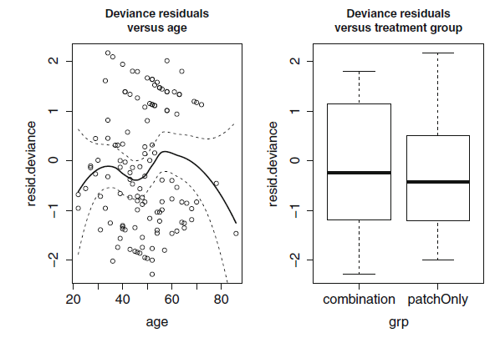
Survival Analysis Track B (Continued): Parametric Regression Techniques
Model Selection: We may fit a model with all covariates as predictors, and then use backwards stepwise regression, using the AIC as a measure of goodness of fit, to select the best model.
Model Fit for Coefficients: Residuals: Is more straightforward than the cox model, we can directly use deviance residuals to analyse the fit of our covariates to the selected model.
EX We can see below that covariate “grp” has a relatively good fit to the model (the residuals are centred around zero). “Age” fits relatively well to a linear model, if we consider the width of the confidence intervals.

